Slide 1
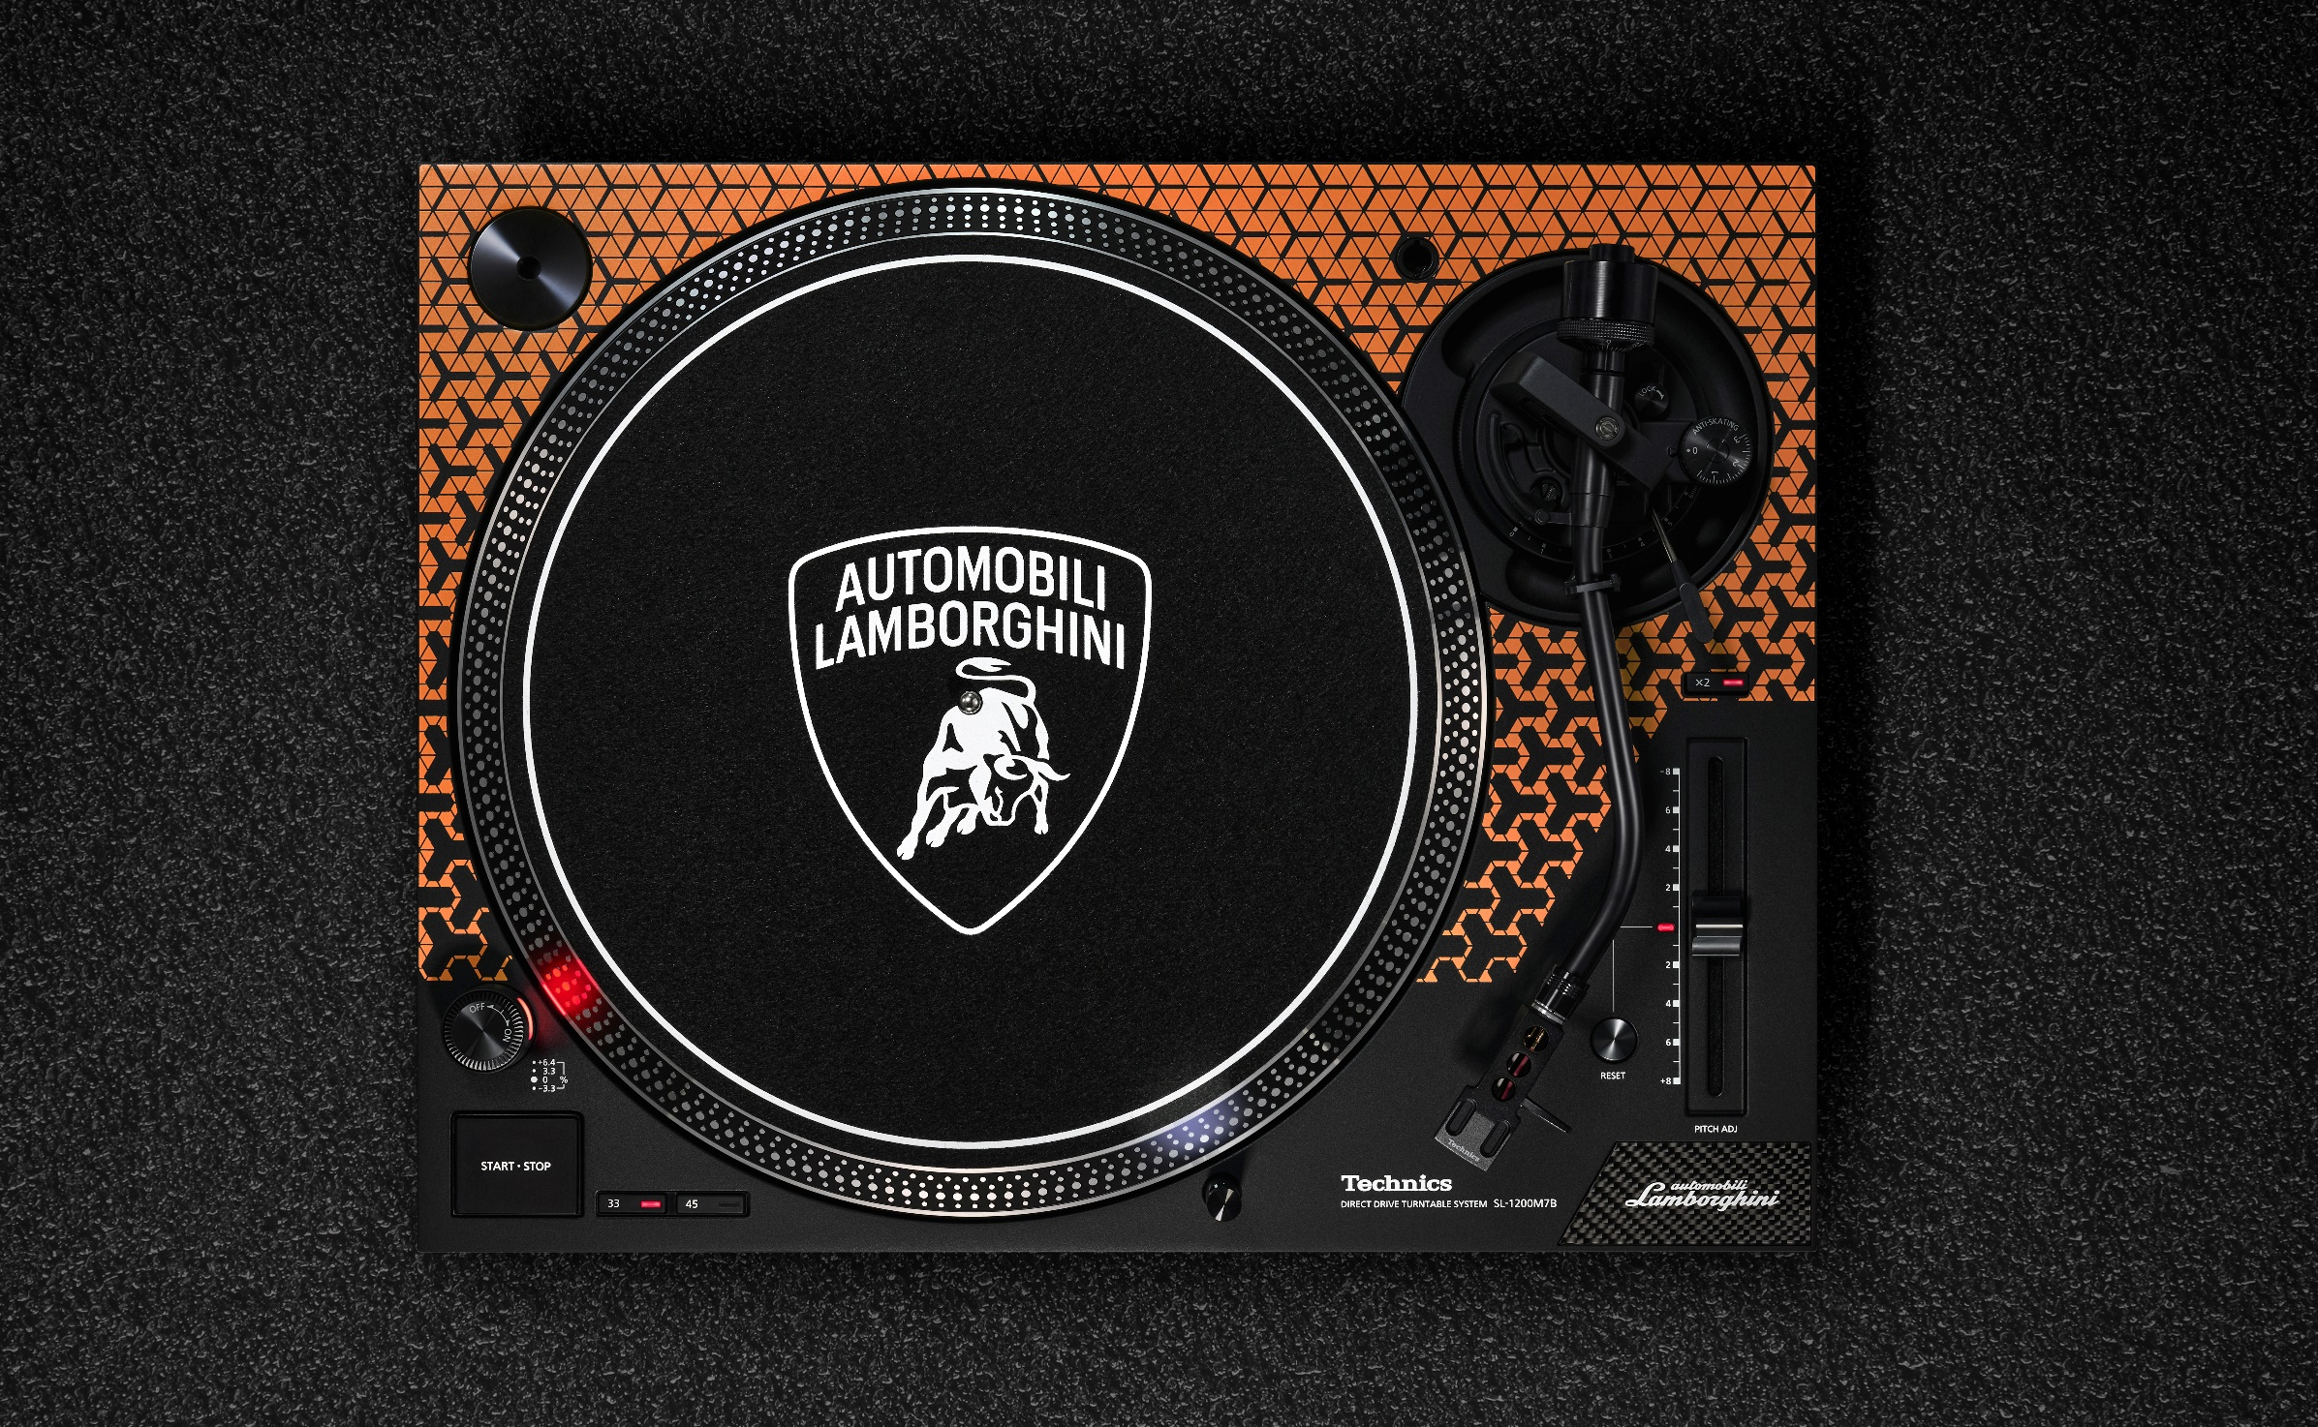
Technics for Automobili Lamborghini
SL-1200M7B
Direct Drive Turntable System
Product Information

Slide 2
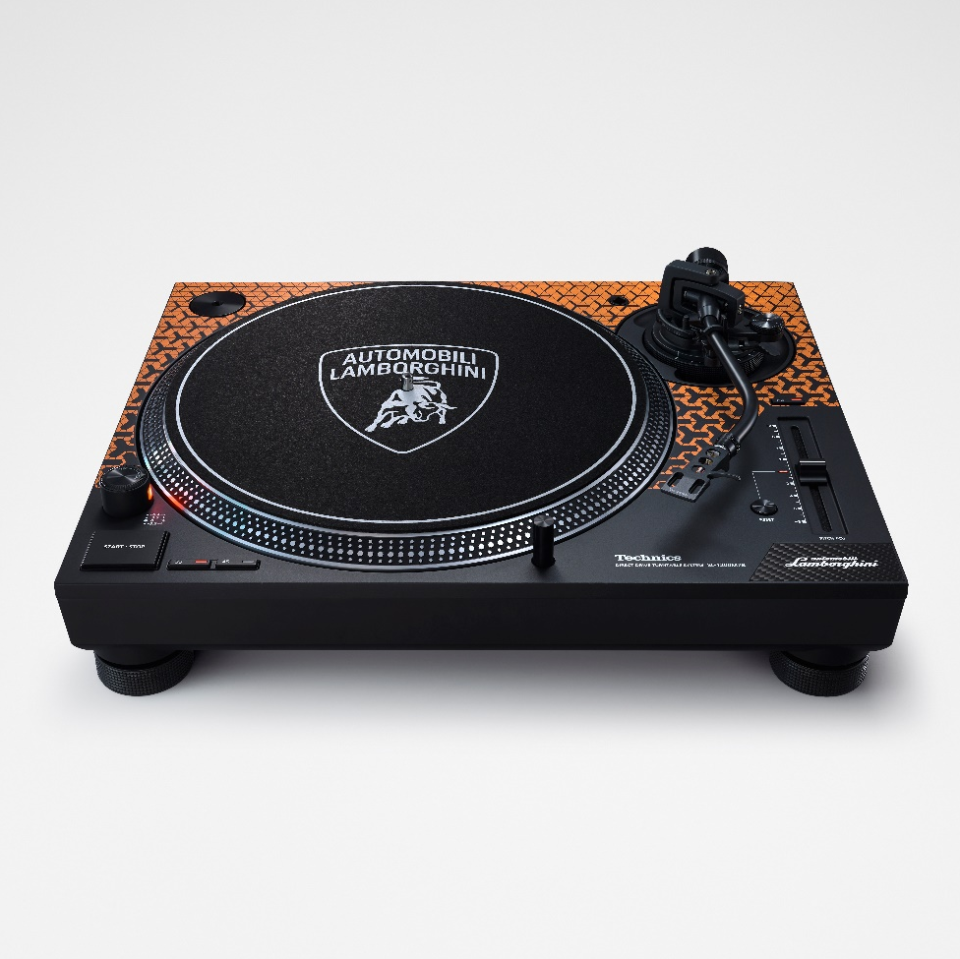
Technics for Automobili Lamborghini SL-1200M7B
Collaboration Background
Designs and Accessories
Technology Features
3
5
8

Slide 3
1．Collaboration Background

Slide 4


Pursuing an Emotive Sound that Touches Any Enthusiast’s Heart
Despite coming from completely different markets, looking back on their 60-year history, both Automobili Lamborghini and Technics share similar values in their underlying corporate cultures. Both engage in thorough technological development using unique ideas to provide customers with unforgettable experiences and are uncompromising in their approach to manufacturing.
Sound is another characteristic element of the two brands. With the overwhelming elation provided by the engine sounds of Automobili Lamborghini and the rich audio experience presented by Technics’ audio solutions, both brands have sought to develop sounds that stimulate the customer.
This collaboration was born from the commonalities between the brands’ concepts and sound making initiatives.

Slide 5
2．Designs and Accessories

Slide 6
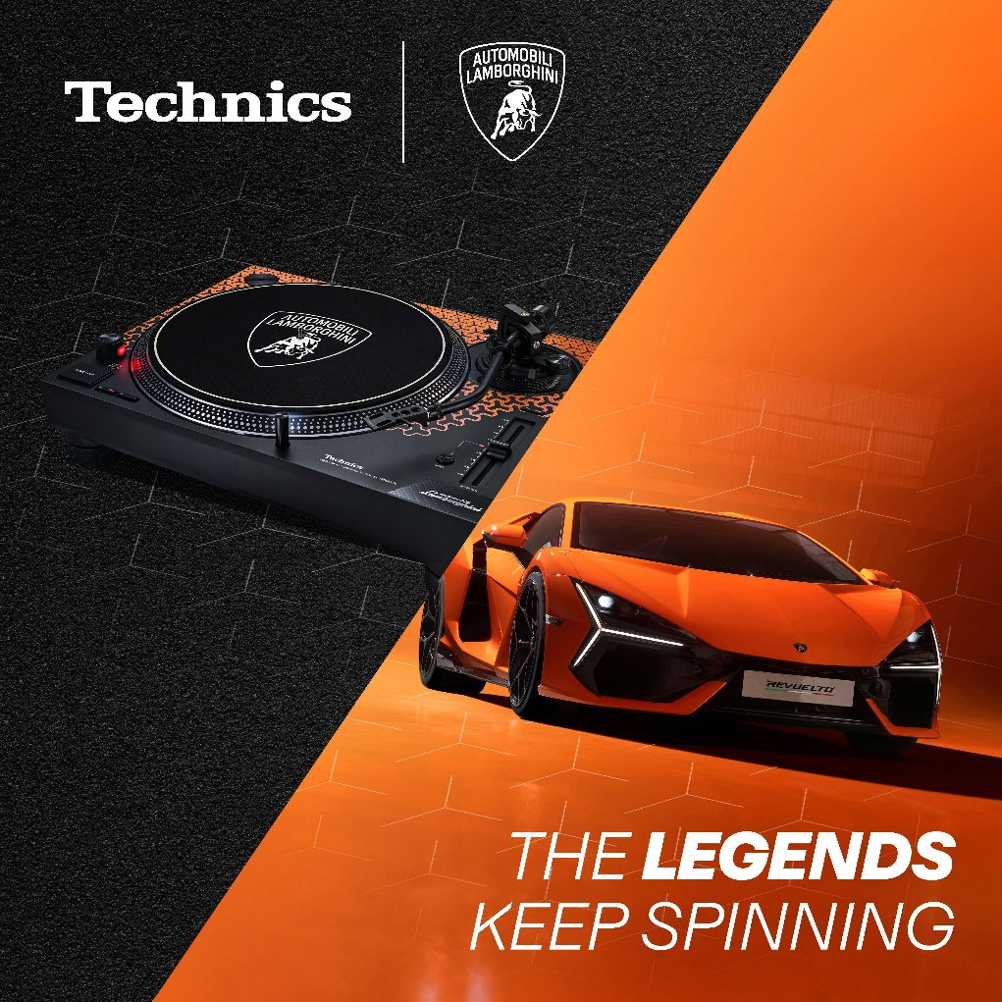
Design Inspired by Lamborghini DNA
The functions of the SL-1200M7B are based on the SL-1200MK7/SL-1210MK7 models, while the design is inspired by Automobili Lamborghini’s iconic Y-shape pattern.
Orange, Green and Yellow are the colours of the SL-1200M7B, based on the most iconic liveries of the Italian automotive brand super sports cars.

Slide 7
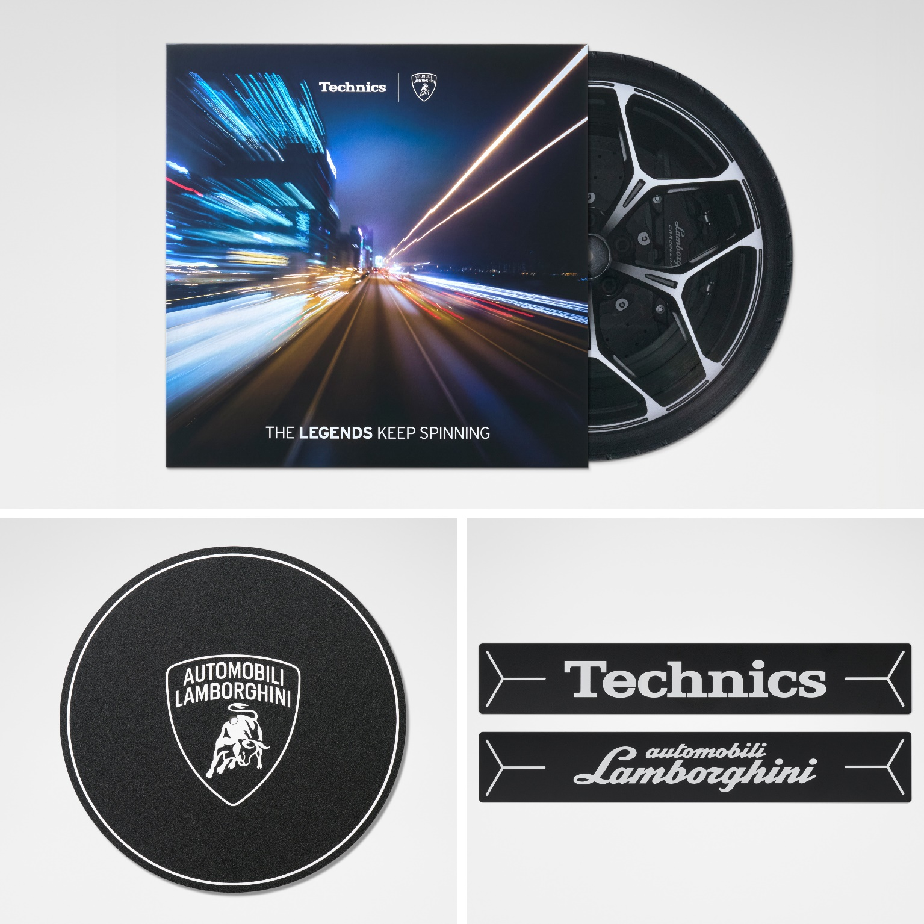
Exclusive gifts
Purchasers of the SL-1200M7B will be treated to an exclusive gift in the form of a vinyl record featuring the powerful engine and driving sounds of six different Lamborghini V12-engine super sports cars, recorded especially for this project:
400GT 2+2
Miura SV
25th Anniversary Countach
Diablo 6.0 SE
Murciélago LP 640
Revuelto
The vinyl itself is a picture disc illustrating the tire of one of Lamborghini's latest models, the Revuelto. Customers can enjoy listening to the engine sounds as the tire spins atop the turntable.
Purchasers of the SL-1200M7B will also receive a slipmat and two stickers with Automobili Lamborghini and Technics logos.

Slide 8
3．Technology Features

Slide 9
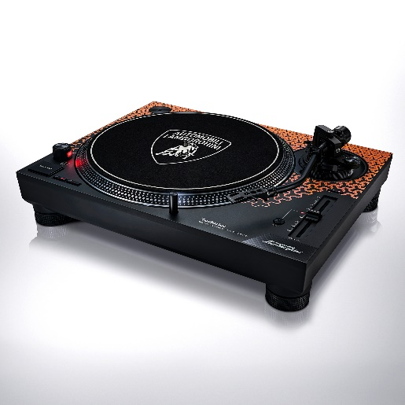
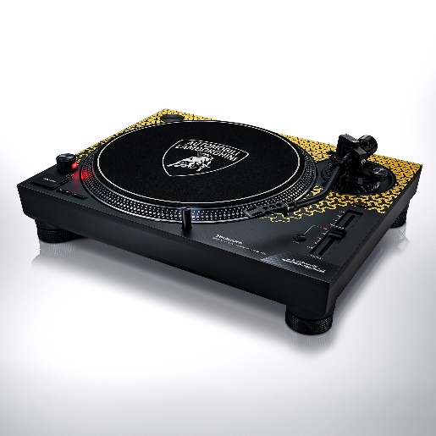
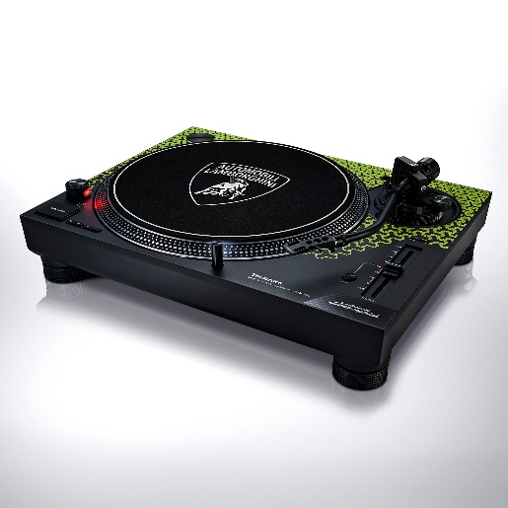
Features of the SL-1200M7B
SL-1200M7B
Direct Drive Turntable System
-Orange
-Yellow
-Green
DJ turntable with performance and function raised to yet higher levels
Coreless direct drive motor with powerful torque and excellent reliability
Audio output and power terminals with detachable cables to allow the use of your favourite phono cable
Torque/brake speed adjustment function
Reverse play function to expand the breadth of DJ play style
Inheriting the exceptional operability of the SL-1200 Series
Adherence to the SL-1200 Series’ traditional layout
Same renowned operating feel as that of the MK Series
High-quality sound reproduction true to the Technics philosophy
Coreless direct drive motor and motor control technology for high rotation stability
Two-layer structure platter offering excellent vibration damping performance
High-rigidity cabinet and high-damping insulator to shut out vibrations
Technical Information

Slide 10
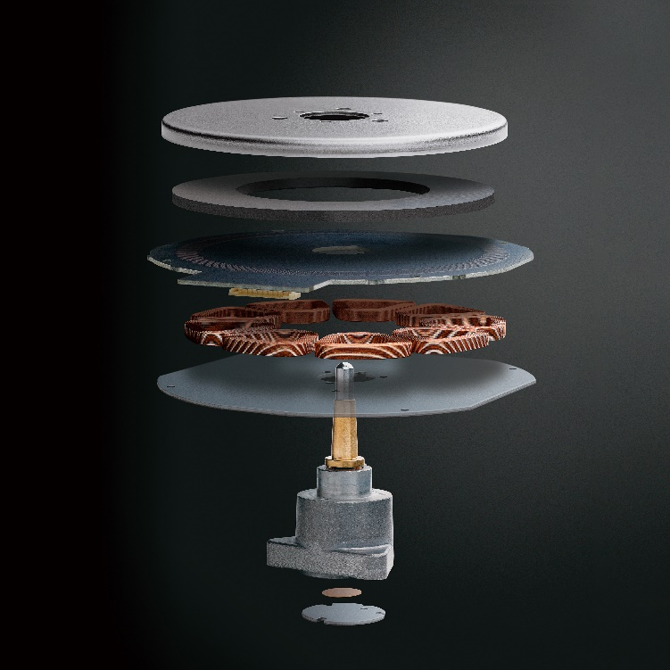
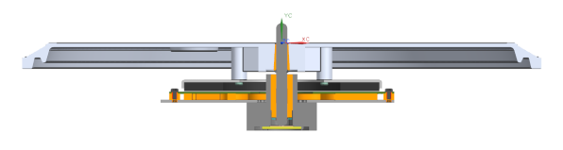
Coreless Direct Drive Motor
Achieves both stable rotation and powerful torque
Coreless Direct Drive Motor
The direct drive system uses a slow-turning motor to directly drive the platter. This system has various advantages. It offers high performance, such as rotation accuracy and powerful torque, does not require replacement of parts and maintains high reliability over a long period of time. On the other hand, the direct drive system was said to produce a rotation irregularity called cogging. For the SL-1200M7B, a new coreless direct drive motor was developed. This motor employs a coreless stator. The removal of the core (iron core) from the stator eliminated the root cause of cogging. Furthermore, the magnetic force of the rotor magnets was improved to the highest possible level, and the gap between the coreless stator and rotor magnets was optimised, thus achieving high torque performance equaling that of the SL-1200MK5.
Boasting smooth rotation and powerful torque, this motor reproduces sound accurately and faithfully from the groove on an analogue record.
Turntable
Shaft
Rotor Yoke
Coil
Magnet
PCB
Housing
Shaft Bearing
Back Yoke
Technical Information

Slide 11
Coreless Direct Drive Motor
Made possible by cutting-edge motor control technology
Starting Torque/Brake Speed Adjustment Function
The SL-1200M7B employs the newest motor control technology refined through the development of Blu-ray disc products. Utilising a microcomputer, this advanced motor control technology ensures high performance in normal rotation and also responds accurately to a wide range of DJ play styles, such as scratching.
The starting torque and brake speed can be adjusted individually to suit the user’s preference.
Enables accurate and stable pitch adjustment
Pitch Control Function
The rotation speed can be set to 33-1/3 rpm, 45 rpm or 78 rpm.* The pitch control function allows fine adjustment of the rotation speed within ±8%/±16%. This function achieves accurate and stable pitch control thanks to full digital control with improved tracking performance and accuracy.
* To use the 78 rpm speed, the switch on the main unit must be turned on.
Technical Information

Slide 12
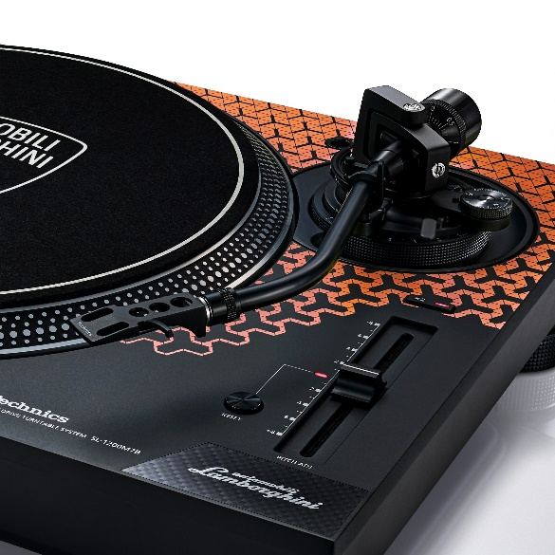
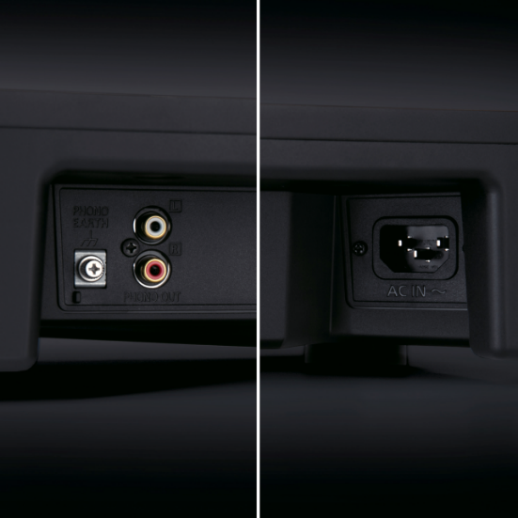
Tonearm
Accurately reads the signal stored in the record groove
High Sensitive Tonearm
The tonearm, which is responsible for accurately reading the signal by tracking the groove on the phonorecord, is a static-balance universal S-shape tonearm, another Technics tradition. The tonearm pipe is made of lightweight, high-rigidity aluminium. The bearing section of the gimbal suspension construction tonearm consists of a machined housing and high-precision bearing to assure excellent tracking performance with minimum stylus jumping even in harsh playing conditions such as scratching.
Prevents cable discontinuity and allows the use of your favourite phono cable
Power/Phono Cable Terminals
The power and phono cable terminals allow detachment of the cables. The phono terminals are gold-plated to minimise sound quality degradation. Since the terminals allow disconnection of the cables, maintenance of the cables is easier, and your favourite phono cable can be connected to let you enjoy the change in sound quality resulting from a different cable.
Technical Information

Slide 13
Coreless Direct Drive Motor
Expands the breadth of DJ play styles
Reverse Play Function
The platter rotates in the reverse direction when the speed selector button and Start/Stop button are pressed simultaneously. This expands the breadth of DJ play styles.
*To use the reverse play function, the switch on the main unit must be turned on.
* The phono cartridge used must support scratch play.
Technical Information

Slide 14
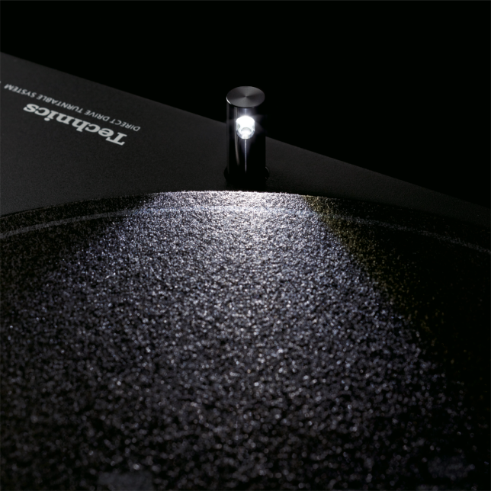
Body
Stylus Illuminator Featuring a High-brightness and Long-life LED
The stylus illuminator features a new push-type structure, and employs a high-brightness and long-life white LED. The illumination area and intensity were reviewed to provide improved visibility of the stylus tip compared to previous models even in a dark environment.
Technical Information

Slide 15
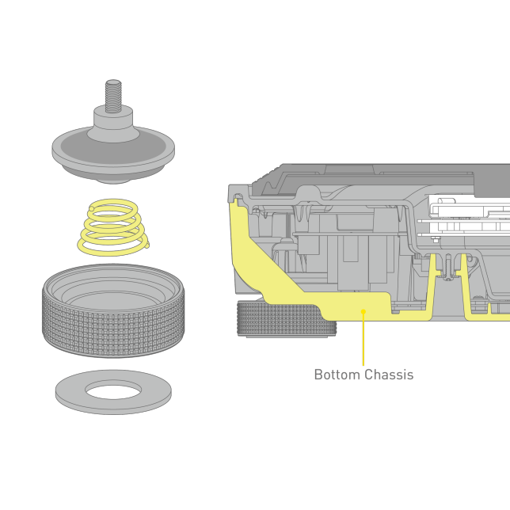
Body & Insulator
Cabinet featuring an anti-vibration construction for thorough shut-out of all vibrations
High Rigidity Cabinet and High Damping Insulator
The chassis, an essential part for reducing external vibrations, inherits the audio quality enhancement technology fostered through the development of high-end turntables. The aluminium die-cast chassis is rigidly integrated with a special material consisting of ABS mixed with glass fibre to achieve a two-layer construction. The combination of this special high-rigidity material and a metal chassis raised the rigidity and vibration-damping performance to higher levels, realising a robust cabinet for beautiful sound reproduction.
The insulator is comprised of a spring and rubber to provide optimal frequency characteristics. This not only assures high sound quality and superb howling resistance, but also effectively shuts out external vibrations under high sound level conditions.
Bottom Chassis
Technical Information

